Slide 1
Tour & Travel Customer Churn
Tour & Travel
Customer Churn
Cahya Aditya
Dibimbing Batch 16
Cahya Aditya dibimbing Batch 16

Slide 2

Cahya Aditya
Tour & Travel
Customer Churn
Cahya Aditya
Dibimbing Batch 16
Passionate about Data Science, Currently i wanna try to switch career in Data Science and Machine Learning, Cause i like about analysis, business, and statistic, trigger me to join with data science. With my experience following various courses, training like in dibimbing.id, MYSKILL, REVOU and some of projects i've been working in Data and some skills that I already have from my previous work experience.

Slide 3



Tour & Travel
Customer Churn
Cahya Aditya
Dibimbing Batch 16
Education
STIE GICI Business School (2016 - 2020)
Bachelor Degree of Management Business
Dibimbing.id (sept 2022 – feb 2023)
Data Scientist
Myskill (2022)
Data Analytics
Revou (2022)
Mini Course Data Analytics

Slide 4
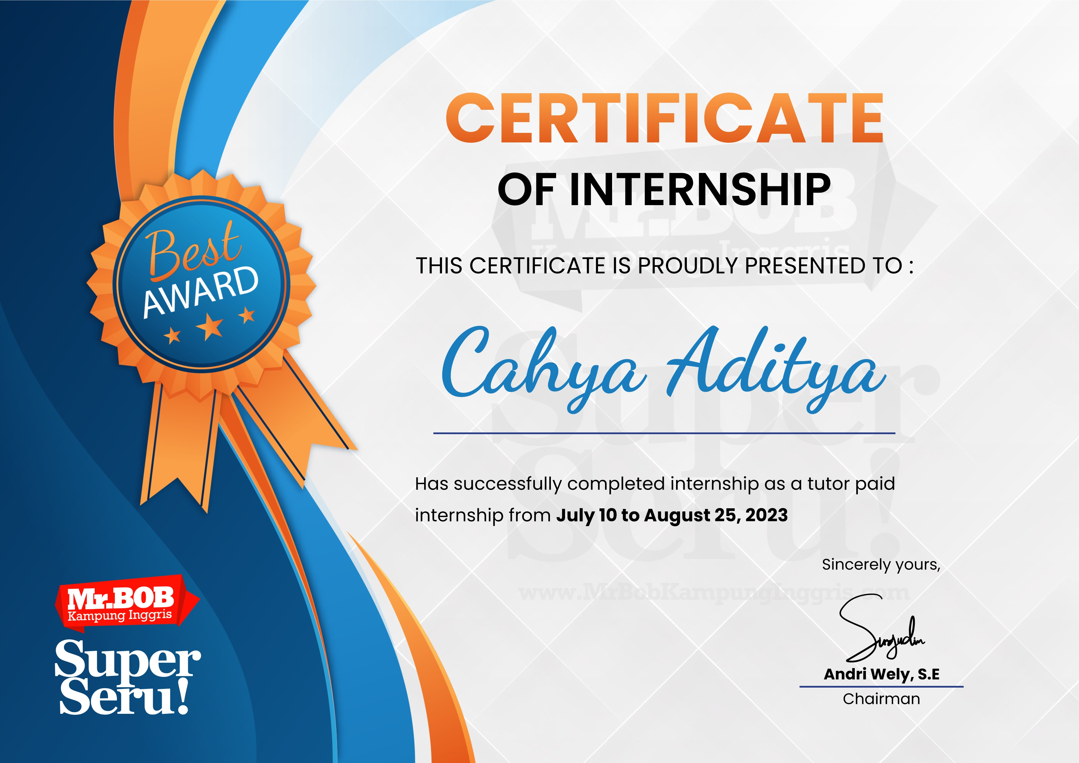
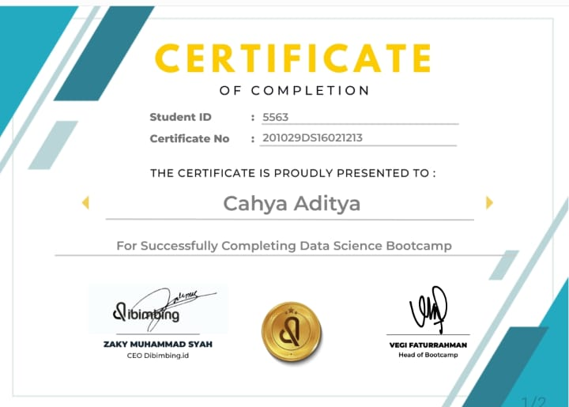
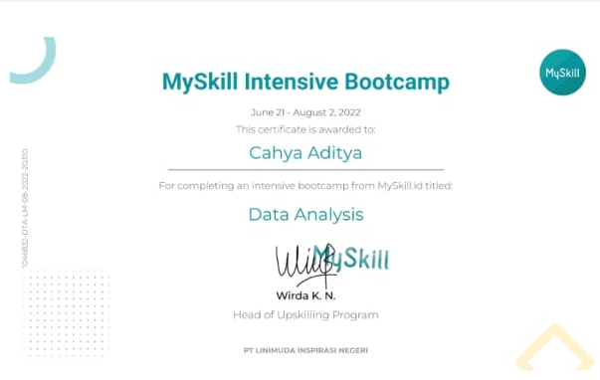
Tour & Travel
Customer Churn
Cahya Aditya
Dibimbing Batch 16
Certificate

Slide 5
Tour & Travel
Customer Churn
Cahya Aditya
Dibimbing Batch 16
STIE GICI Business School – Marketer
(2016 - 2018)
- Working in Marketing Departement STIE GICI - Share info Highschool Student at Bogor - Make event workshop at campus
CV Syifa Herbal Alami – Admin Marketplace
(2019 - 2021)
- Operate sale Marketplace Shopee account - Process trouble buyer and seller about refund - Reply chatting customer
Working Experience
PT Midi Utama Indonesia – Staff
(2021 - 2023)
- Check of safe money at Store - Entry data product Stock Opname - Do adjustment till fix to Store

Slide 6
Tour & Travel
Customer Churn
Cahya Aditya
Dibimbing Batch 16
Skills
softskills
hardskills
Communicartion
Public Speaking
Analytical Thinking
Problem Solving
Pyhton
SQL
Google Colab
Google Data Studio
Excel

Slide 7

Tour & Travel
Customer Churn
Cahya Aditya
Dibimbing Batch 16
Project and Portofolio
Tour and Travel Customer Churn
Exploratory Newbie Data Scientist
Final Project
In MySkill
Analysis Supervised Learning in Tour and Travel Company
A project that Exploratory Data in Machine Learning for newbie as Data Scientist
Final Project during bootcamp in MySkill that basic query of SQL

Slide 8
Data Science Project
Tour & Travel
Customer Churn
Cahya Aditya
Dibimbing Batch 16
Tour and Travel Customer Churn

Slide 9
Table of Content
Tour & Travel
Customer Churn
Cahya Aditya
Dibimbing Batch 16
1
2
Data Preparation
Exploration Data
3
4
Machine Learning Model
Conclusion Recommendation

Slide 10
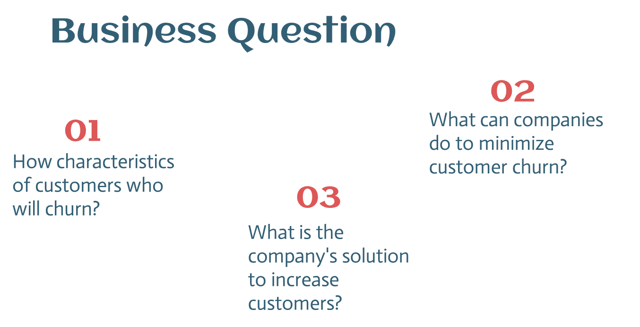

Slide 11
Data Preparation
Tour & Travel
Customer Churn
Cahya Aditya
Dibimbing Batch 16

Slide 12
7
954
feature
rows

Slide 13
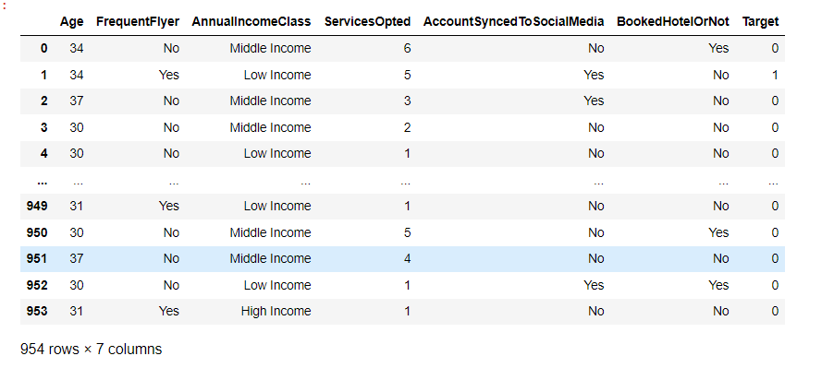
Dataset Info

Slide 14
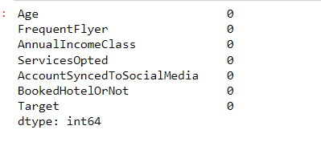
Data Cleaning

Slide 15
Exploration Data
Tour & Travel
Customer Churn
Cahya Aditya
Dibimbing Batch 16

Slide 16
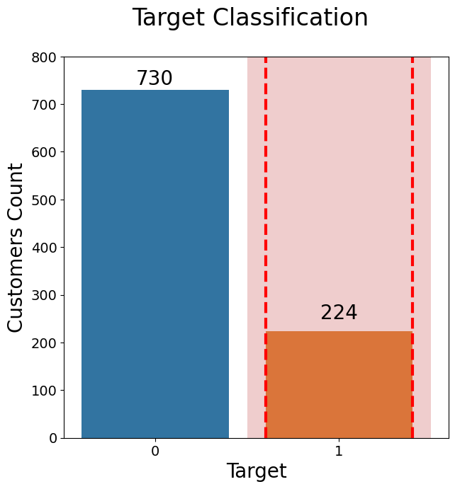
Churn
If we see from the data aside,
it said that costumers who did churn were 224 or around 23%.

Slide 17
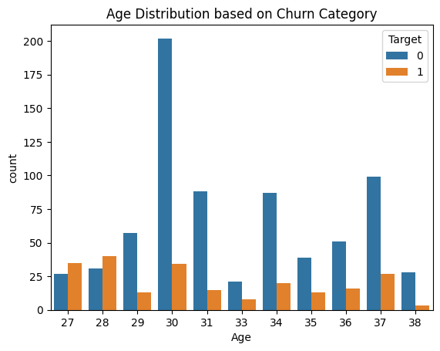
Age
The most customers who churn are age 27-28 years, the most number of customers are the majority age 30.

Slide 18
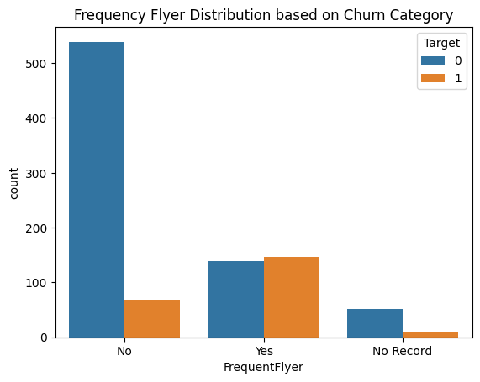
FrequentFlyer
From this data, customers who frequently make flights have the highest churn rate.
And if you look at the number of customers, the majority of customers do not make flights.

Slide 19
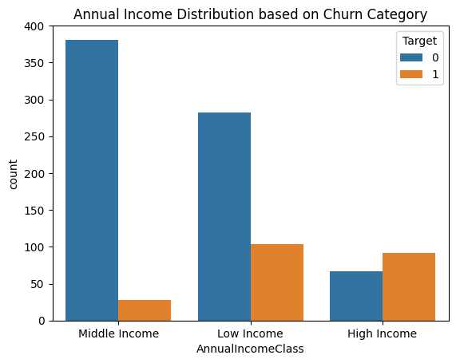
AnnualIncomeClass
From this data, customers who has highest churn are
low income category.

Slide 20
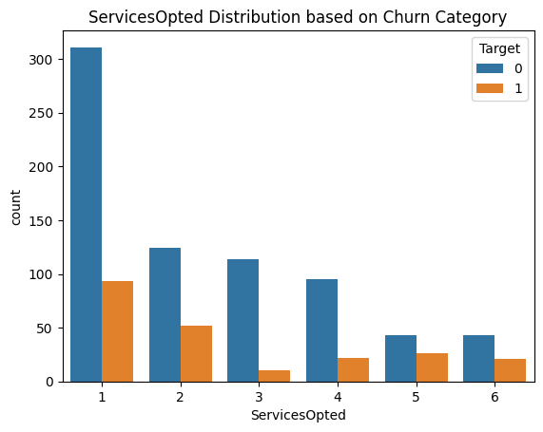
ServicesOpted
Type 1 services used by customers have the
highest churn rate compared to customers who use 3-6 services from travel services.

Slide 21
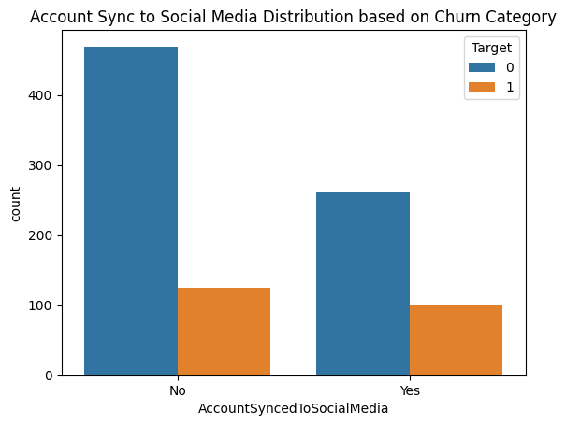
AccountSyncedToSocialMedia
From this explanation, we can assume that if
Customers don’t Connect their social media accounts with the customer accounts they use, they actually have a high churn rate.

Slide 22
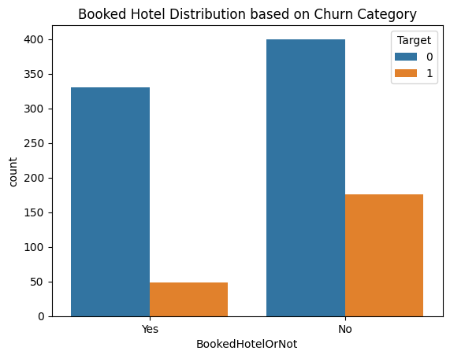
BookedHotelOrNot
The number of customers who do not order lodging directly from travel service providers is the highest, and also the highest for churn. This could be of more concern to the company.

Slide 23
Machine Learning Model
Tour & Travel
Customer Churn
Cahya Aditya
Dibimbing Batch 16

Slide 24
Baseline Models
Nama Model | Akurasi | Presisi | Recall | F1-Score | Method
KNN (default) | 0,87 | 0,78 | 0,65 | 0,71 | Baseline
KNN (n=1) | 0,88 | 0,79 | 0,71 | 0,74 | KNN( N=1)
Random Forest | 0,88 | 0,79 | 0,66 | 0,72 | Baseline
Decision Tree | 0,89 | 0,79 | 0,72 | 0,75 | Baseline
Logistic Regression | 0,8 | 0,65 | 0,38 | 0,48 | Baseline
Naïve Bayes | 0,8 | 0,58 | 0,62 | 0,6 | Baseline
Gradient Boosting | 0,88 | 0,78 | 0,73 | 0,76 | Baseline
XGBoost | 0,9 | 0,833 | 0,74 | 0,78 | Baseline
CatBoost | 0,88 | 0,79 | 0,71 | 0,74 | Baseline
LightBeam | 0,9 | 0,82 | 0,75 | 0,78 | Baseline

Slide 25
Result
Nama Model | Akurasi | Presisi | Recall | F1-Score | Method
LightBM | 0,88 | 0,7 | 0,87 | 0,78 | SMOTE
Gradient Boosting | 0,87 | 0,68 | 0,91 | 0,78 | SMOTE

Slide 26
Conclusion Recommendation
Tour & Travel
Customer Churn
Cahya Aditya
Dibimbing Batch 16

Slide 27
Conclusion
1. The highest number of customers is 27-28 years old and the highest number of customers is in their 30s.
2. Customers with low income are said to have the highest churn rate, maybe companies can concentrate more on this category.

Slide 28
Conclusion
3. Synchronization of customer accounts with personal social media accounts greatly influences the churn rate.
4. Lodging is also a concern for companies because, judging from the previous data, many customers do not use lodging services directly.

Slide 29
Recommendation
1. Companies can make a promotion for the category of customers aged < 30 years, by making free lodging.
2. In each trip, the company can create a giveaway program on social media when a customer uses the service, where the goal is for the customer's account to be connected to the customer's social media account.

Slide 30
Recommendation
3. For customers with the Low category, the company can make
a price discount when a customer brings in a new customer with the conditions that have been made.

Slide 31

Thanks
cahyaadit12@gmail.com
+62 8559856604
https://www.linkedin.com/in/cahya-aditya-c1223/
https://medium.com/@cahyaaditya1223/tour-and-travel-customer-churn-39f333aca1c0
Please keep this slide for attribution

